Slide 1
Pokemon Resources and Team Builder
For Pokemon Black 2
By Nishad Yedunuthula, Kobe Kimoto-Ross

Slide 2
Introduction
Our project is to create a database holding all Pokemon and battles from Pokemon Black 2. In order to assist people with their playthrough, we’ll provide information on routes and encounters along with team building so the player can keep track of their teams and strategies.

Slide 3
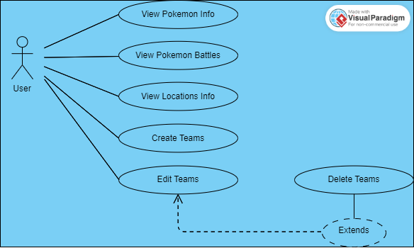

Slide 4
UML Diagram Main Use Cases
View Pokémon Info:
The user can search a Pokémon and view relative information such as typing and ability.
View Pokémon Battles:
The user can view trainer battles throughout the game.
View Locations Info:
The user can view trainers and wild Pokémon in a chosen area.
Create Teams:
The user can assemble a team consisting of up to six Pokémon and store the Pokémon’s abilities, stats, and levels.
Edit Teams:
The user can update their teams as they progress.
Delete Teams:
The user can delete teams when he no longer uses them.

Slide 5
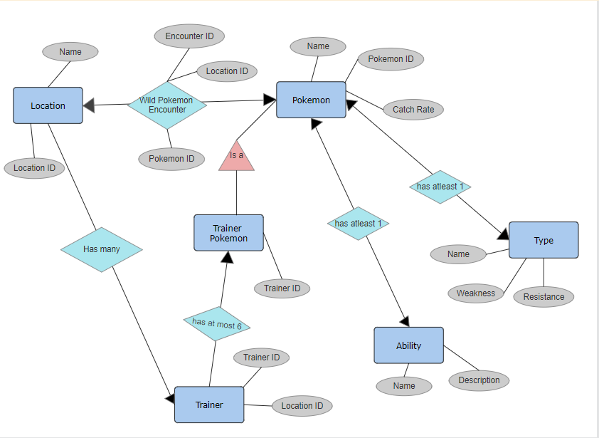
ER Diagram

Slide 6
Schema
Pokemon
p_pokemonID, p_name, p_catchRate
Trainer
tr_trainerID, tr_locationID
Trainer Pokemon
tp_trainerID
Wild Pokemon Encounter
e_encounterID, e_pokemonID
e_locationID
Location
l_locationID, l_name
Type
t_weaknesses, t_name
t_resistances
Ability
a_description, a_name

